Slide 1
iOS Training User Map View App 1/3 (TableView and local model)
November, 2012
Disclaimer:
This process description is current as of November, 2012 and is subject to change without notice.

Slide 2
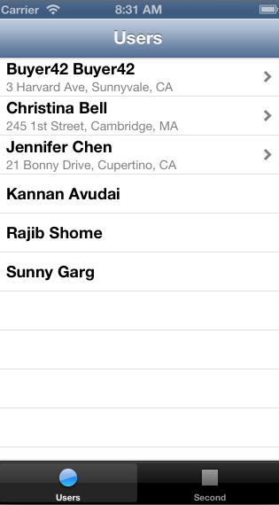
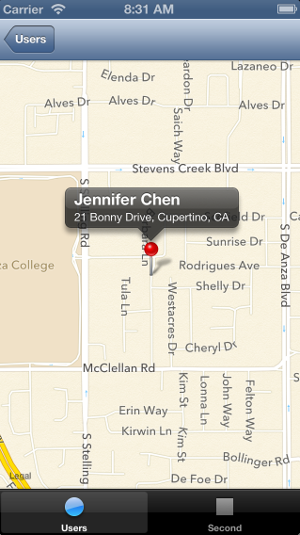
The goal

Slide 3
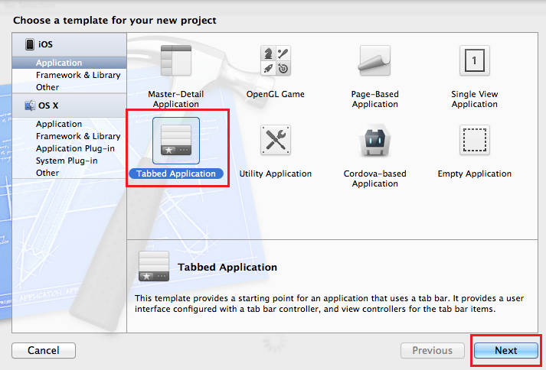
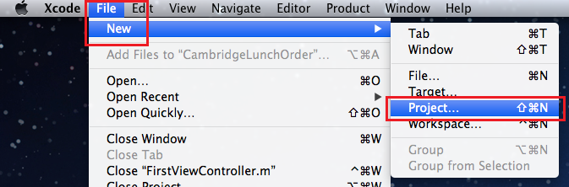
Create a new Xcode project 1/2
Create a new Xcode project based on the Tabbed application template.

Slide 4
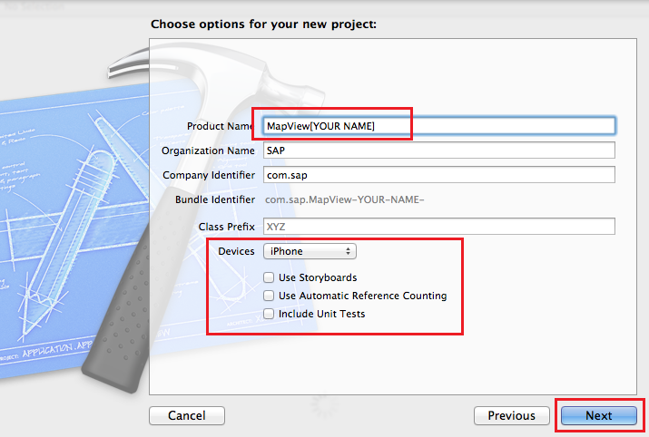
Create a new Xcode project 2/2
Name the project MapView[Your Name]
Don’t use storyboard or ARC

Slide 5
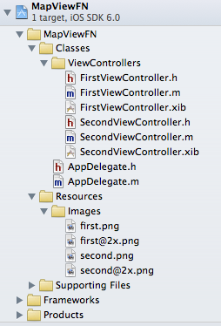
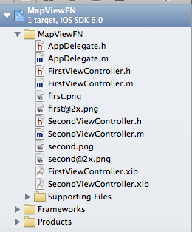
Optimize the project structure
Optimize the structure of your project by creating new groups and moving files into them.

Slide 6
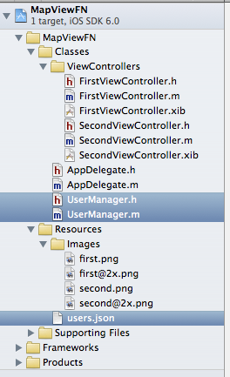
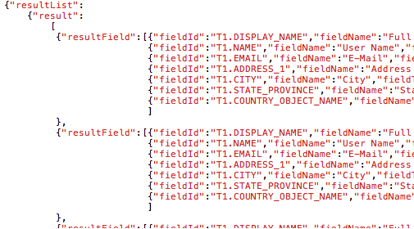
Import additional files into the project
Extract the archive with the files for this exercise.
Import UserManager.h and UserManager.m into the classes folder of the project.
Import users.json into the Resources folder of the project.

Slide 7
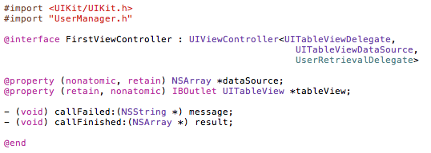
Add table view related protocols FirstViewController.h
The implementation of the UITableViewDelegate is required to be able to interact with the table view, for example to respond to taps.
In order to populate a table view, the view controller has to adhere to the UITableViewDataSource protocol.

Slide 8
Add model related entries FirstViewController.h
The class UserManager will be the model for this application.
The ViewController has to import it’s header file to utilize it’s methods and adhere to the protocol to be the model’s delegate

Slide 9
Define properties FirstViewController.h
Define a property for the TableView’s datasource
Define a property to for the TableView to send messages to and access properties of the TableView.

Slide 10
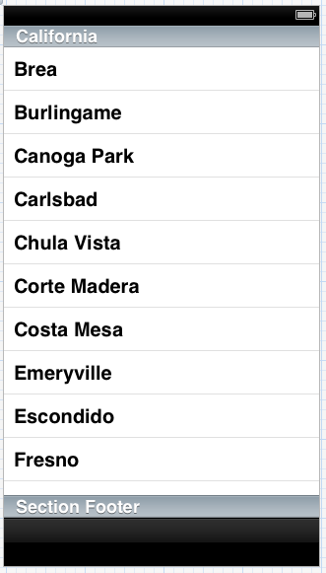
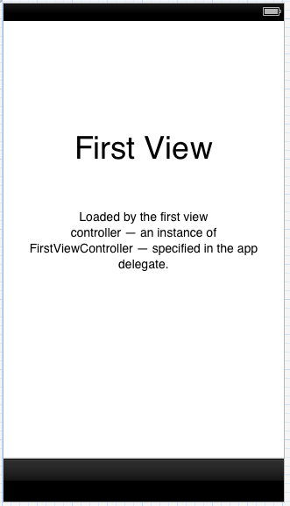
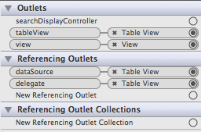
Adjust the ViewController layout and connections FirstViewController.xib
Remove the placeholder UILabel and UITextView.
Add a TableView and make it fill out the entire screen.
The end result should look like this
Create the connections
for the File’s Owner

Slide 11

Import header files FirstViewController.m
Import the header files for the FirstViewController and the UserManager

Slide 12
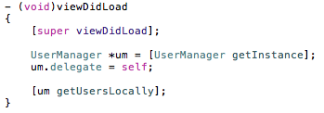
Adjust viewDidLoad to retrieve data from the model FirstViewController.m
Singleton pattern is used to get access to the model.
The view controller will be the initiator of the data retrieval as well as the delegate to handle the result.

Slide 13
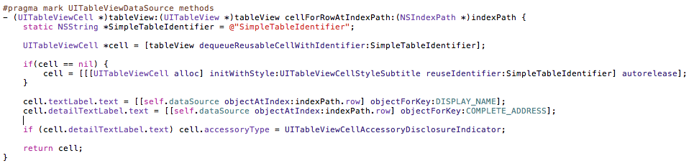
Implement the UITableViewDataSource protocol 1/2 FirstViewController.m
Implement the tableView:cellForRowAtIndexPath: method.
This method is used by the TableView to inquire about the layout and content of a cell for a particular row.
The code is creating a cell based on the data source content.

Slide 14
Implement the UITableViewDataSource protocol 2/2 FirstViewController.m
Implement the tableView:numberOfRowsinSection: method.
This method is used by the TableView to inquire about the number of rows in a section or rather, in this exercise, for the entire TableView.

Slide 15

Implement the UserDataRetrievalDelegate protocol 1/2 FirstViewController.m
Update the content of the TableView’s data source and let the TableView reload it’s data.

Slide 16

Implement the UserDataRetrievalDelegate protocol 2/2 FirstViewController.m
A UIAlertView (alert pop-up dialog) is used to inform the user that the retrieval of the user data has failed.

Slide 17
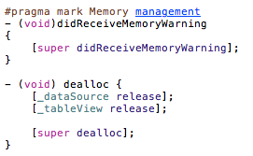
Adjust dealloc for proper memory management FirstViewController.m
Make sure to release all retained properties in the dealloc method

Slide 18
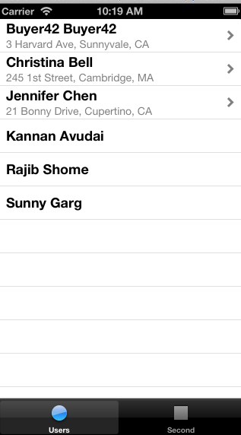
Run your application
The application should look like this

Slide 19
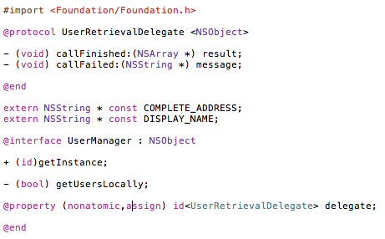
A look at the model UserManager.h
Delegates will have to implement behaviors depending on the outcome of the user retrieval.
The model is defining a protocol with two methods that delegates will have to conform to.
The model is delivering the retrieved user data in a dictionary and therefore has to publish the keys to access the data as externally available constants.
The model is implemented as singleton.

Slide 20

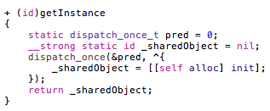
A look at the model UserManager.m
Definition of the actual values for the constants
Class method to (create and) return the shared instance of the model. dispatch_once is guaranteed to execute the code in the associated block exactly once.

Slide 21
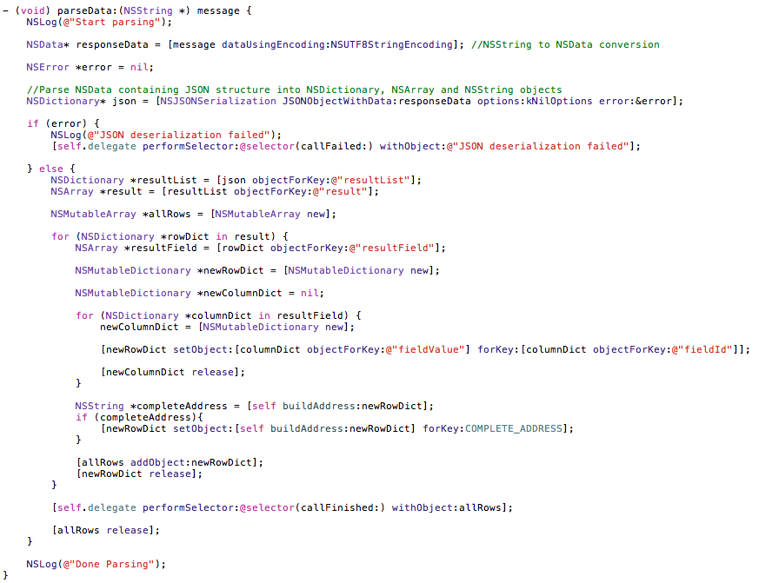
A look at the model JSON Parsing
The NSJSONSerialization class is used to convert JSON data to foundation objects.

Slide 22
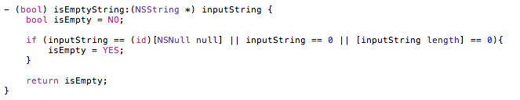
A look at the model String utility method
The method below checks for all variations of an empty string.
This could have also been implemented as a category for NSString.

Slide 23
iOS Training User Map View App 2/3 (Nav Controller & MapView)
November, 2012
Disclaimer:
This process description is current as of November, 2012 and is subject to change without notice.

Slide 24
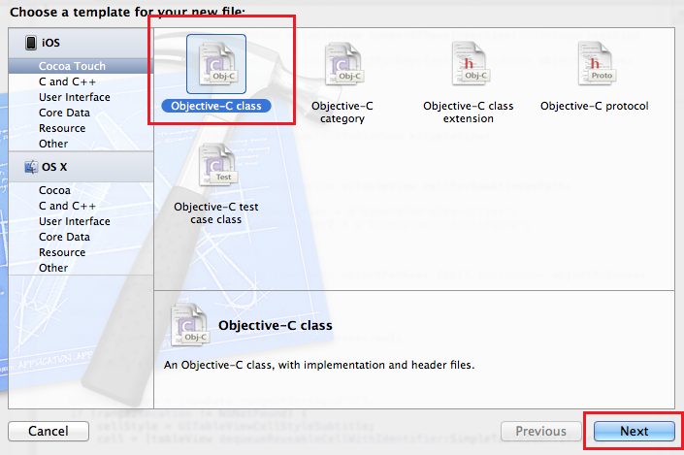
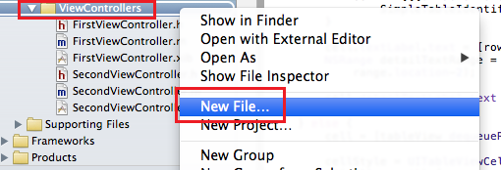
Create a new view controller 1/2

Slide 25
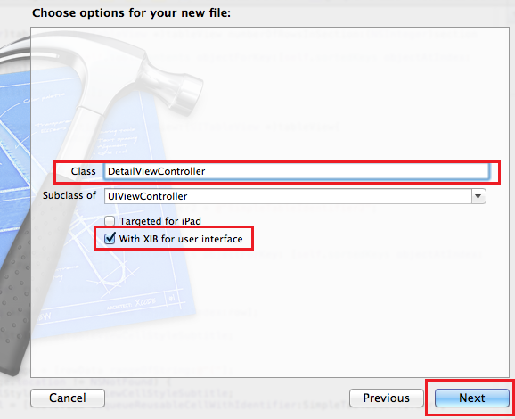
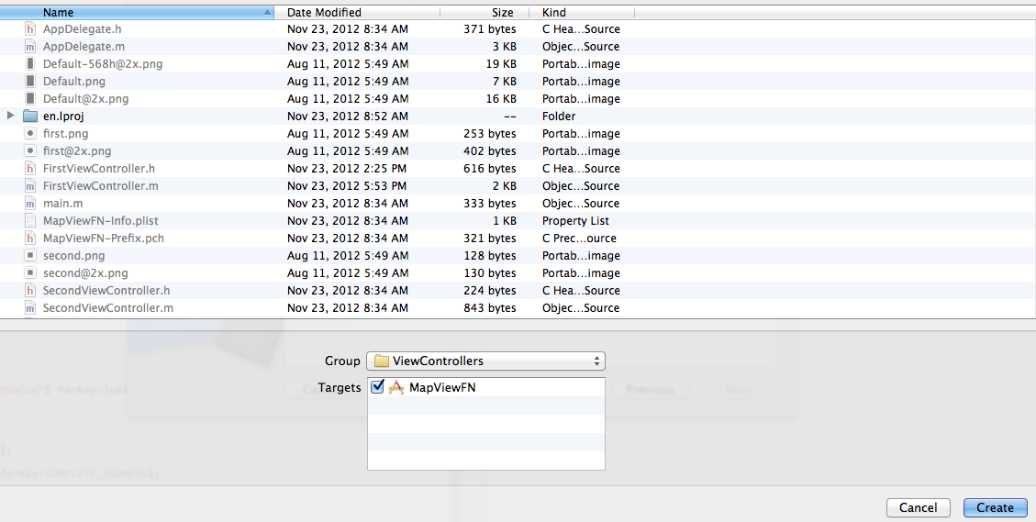
Create a new view controller 2/2
Name the new view controller DetailViewController

Slide 26
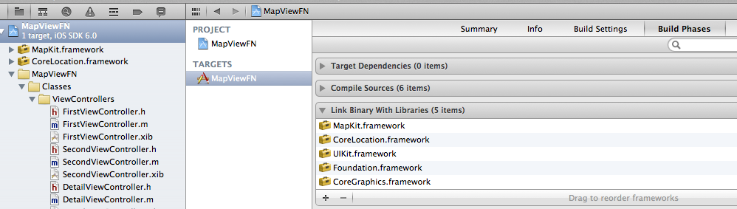
Add required frameworks
Add the MapKit and CoreLocation frameworks which will be needed for map display and geo coding

Slide 27
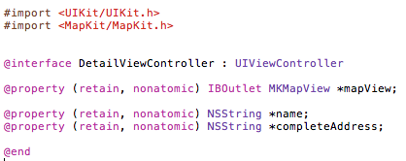
Define properties DetailViewController.h
Add properties to:
Access the MapView from the code
Store the name and address of the selected user

Slide 28

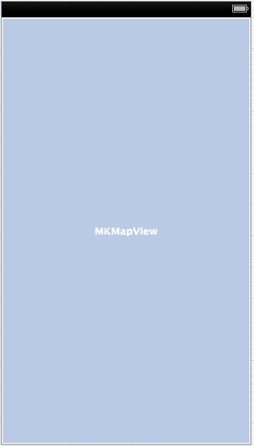
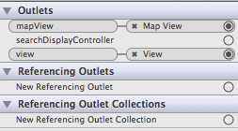
Adjust the ViewController layout and connections DetailViewController.xib
Add a Map View
Create the connections for the File’s Owner

Slide 29
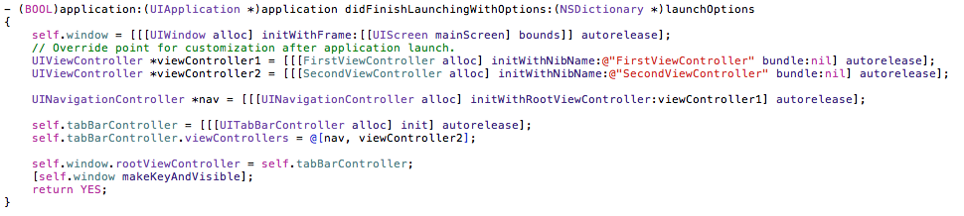
Adjust application:didFinishLaunchingWithOptions: Appdelegate.m
Create a navigation controller in the code and assign the first view controller to it.
Then make the navigation controller the first tab of the tab bar controller.

Slide 30

Import header files FirstViewController.m
Import the header file of the DetailViewController in order to make the DetailViewController accessible by the FirstViewController.

Slide 31
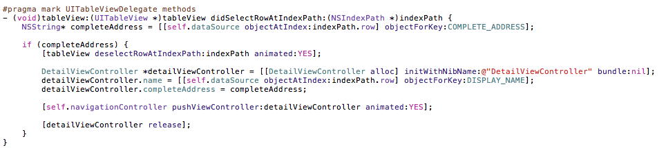
tableView:didSelectRowAtIndexPath: FirstViewController.m
Create and show the detail controller when a cell / row in the table view gets selected.
tableView:didSelectRowAtIndexPath: is a method of the UITableViewDelegate protocol.

Slide 32
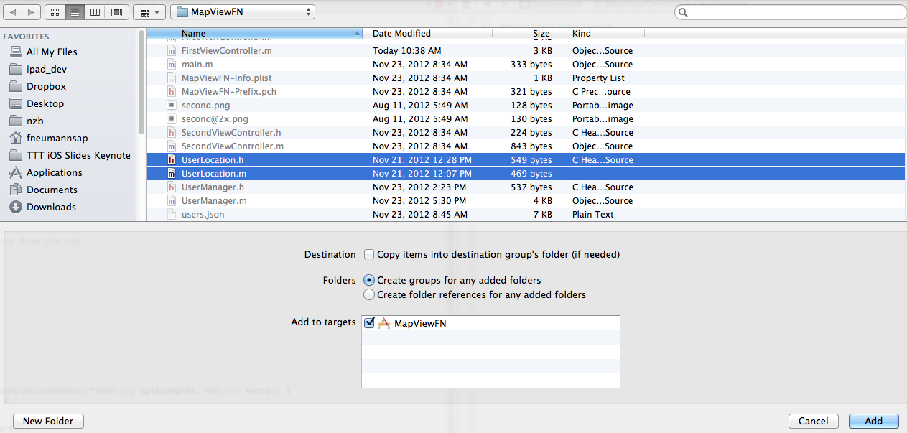
Import additional files into the project
Import the files (.h/.m) for the UserLocation class into the project.

Slide 33

Import header files DetailViewController.m
Import the header files of the DetailViewController and UserLocation class.

Slide 34
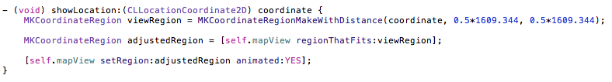
showLocation: DetailViewController.m
This method is centering the map view around the given coordinates.
It contains the following steps:
Creates a region 0.5 miles high and wide with the coordinates as center.
Uses the map view to adjust the region to fit inside the map view’s frame
Displays the region on the map view

Slide 35
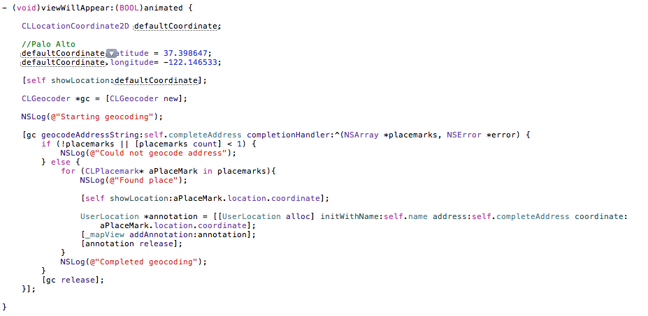
viewWillAppear: DetailViewController.m
Geo-coding is used to translate the address into coordinates. This realized via an asynchronous call to the geo-coding server.
The handler block of the geo coder is used to center the map around the coordinates and to add an annotation.

Slide 36
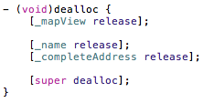
Adjust dealloc for proper memory management DetailViewController.m
Make sure to release all retained properties in the dealloc method

Slide 37
Run your application

Slide 38
iOS Training User Map View App 3/3 (External model)
November, 2012
Disclaimer:
This process description is current as of November, 2012 and is subject to change without notice.

Slide 39
Adjust the model to make a web service call instead of reading the data from the local JSON file

Slide 40
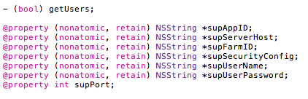
Adjust header file of the model UserManager.h
Add a method to get the users via a web service call to the model.
Add properties to store the SAP Mobile Platform (SUP) settings.

Slide 41
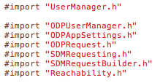
Import SUP header files UserManager.m
Add the SUP header files to the model

Slide 42
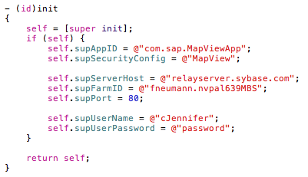
Override the model’s init method UserManager.m
Hard-code the values for SUP in the overridden init method.

Slide 43

Implement isReachable to check for connectivity UserManager.m
The isReachable method can be used to determine if the device is reachable for internet connections. It will for example return false in case the air plane mode has been enabled.

Slide 44
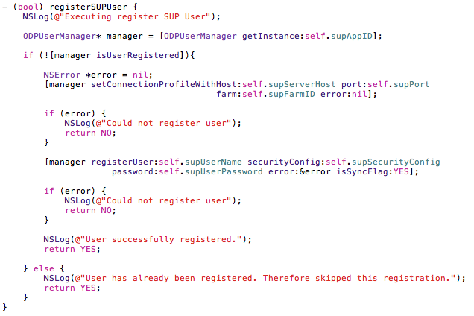
Implement registerSUPUser for SUP user registration UserManager.m
Automatic registration of a user in SUP

Slide 45
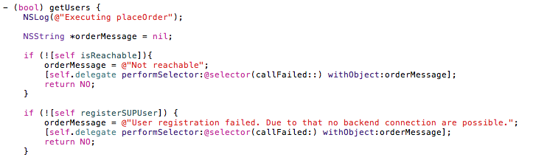
Implement getUsers to make a web service call 1/3 UserManager.m
Check for reachability first and don’t proceed if an internet connection cannot be established.
Register the current device user in SAP and don’t proceed if this failed.

Slide 46
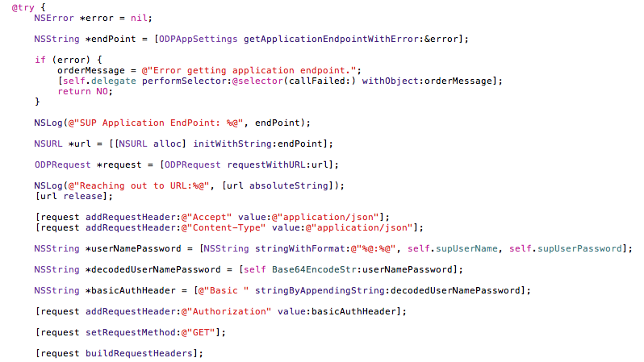
Implement getUsers to make a web service call 2/3 UserManager.m
Get the WS URL from SUP
Add request headers to indicate that JSON should be used in either direction
Use header based basic authentication
Indicate that HTTP GET should be used for the WS call
Build the request headers

Slide 47
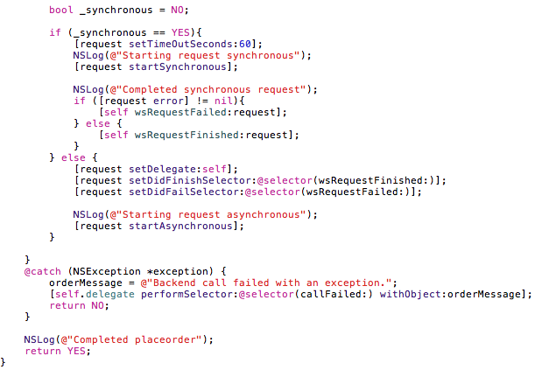
Implement getUsers to make a web service call 3/3 UserManager.m
Either execute the WS call synchronously or synchronously

Slide 48
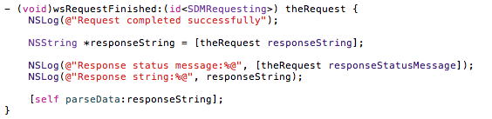
Implement wsRequestFinished UserManager.m
wsRequestFinished: is the delegate which is getting called after a successful synchronous or asynchronous web service call.
It will log the response content and hand it over to the JSON parsing.

Slide 49
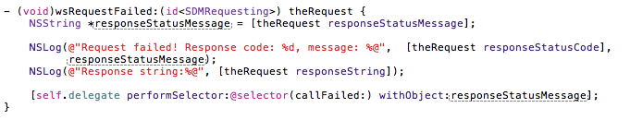
Implement wsRequestFailed UserManager.m
wsRequestFailed: is the delegate which is getting called after a failed synchronous or asynchronous web service call.
It will log the response code and content and call the delegate to notify the user

Slide 50
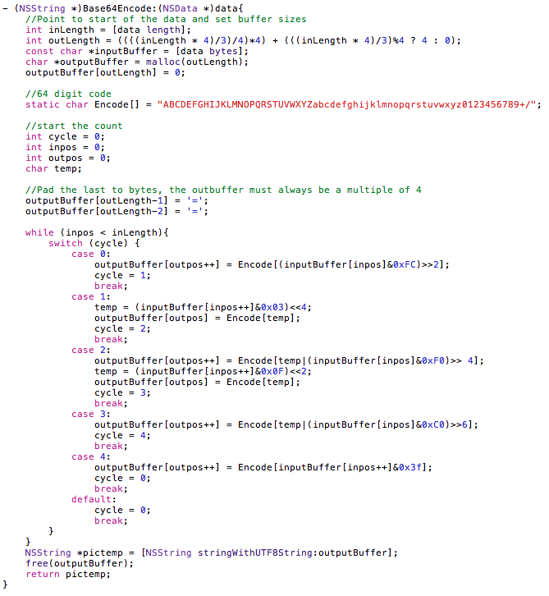

Implement Base64Encode and Base64Encodestr UserManager.m
Implement the base 64 encoding which is needed to encode the username and password for the header based basic authentication

Slide 51
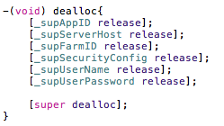
Adjust dealloc for proper memory management UserManager.m
Release the SUP properties in dealloc:

Slide 52
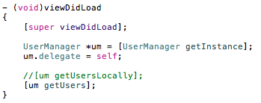
Adjust viewDidLoad to retrieve data via web service call FirstViewController.m
Comment out the code which is getting the users locally.
Add code to get the users via web service call.

Slide 53
Use an activity indicator to let the user know that a the user data retrieval is in progress

Slide 54
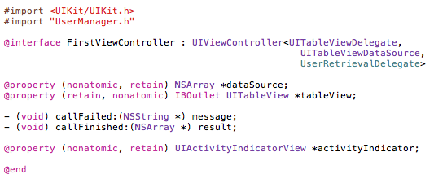
Add a property for the activity indicator FirstViewController.h
Add a property for the activity indicator.

Slide 55
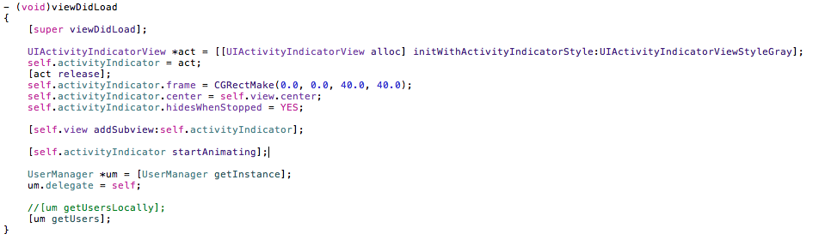
Adjust viewDidLoad to utilize the activity indicator FirstViewController.m
Create the activity indicator and start animating it before the call to the model.

Slide 56
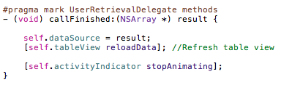

Adjust callFinished and CallFailed FirstViewController.m
Stop the activity indicator when the call has been completed.

Slide 57
Thank you
Contact information:
Frank Neumann
f.neumann@sap.com

